Slide 1

BERT: From Transformers to Bidirectional Understanding
DATASCI 224 Spring 2026
Manal Ahmed

Slide 2
Why Do We Need BERT?
Two sentences, one word: 'bank’
"The bank is near the river."
"I deposited money in the bank."
Key Points:
- Traditional NLP struggled with context
Understanding language requires surrounding words
One word, many meanings → context matters
Notes:
Think about the word 'bank.' In the first sentence, 'The bank is near the river,' it probably means the ground next to the river. But in 'I deposited money in the bank,' it's a financial institution. Same word, completely different meaning.
For decades, traditional NLP methods couldn't reliably understand which meaning was intended without a lot of manual rule-writing. BERT solved this by learning to use surrounding context —> both what comes before AND after a word —> to understand its true meaning. This is the core problem BERT addresses.

Slide 3
What Are Transformers? (Quick Review)
Three Key Features of Transformers
Attention Mechanism Learns which words in a sentence are most important to focus on.
Encoder- Decoder Architecture The encoder understands the input, and the decoder generates the output.
Parallel Processing Processes all words simultaneously, making training much faster than RNNs.
Simple Transformer Workflow:
Input Sentence ↓ Transformer ↓ Output
Notes:
You've already learned that Transformers use attention to process words in parallel and understand relationships between words. BERT keeps that foundation but makes three major changes to how language is learned. Let's explore those innovations now.

Slide 4
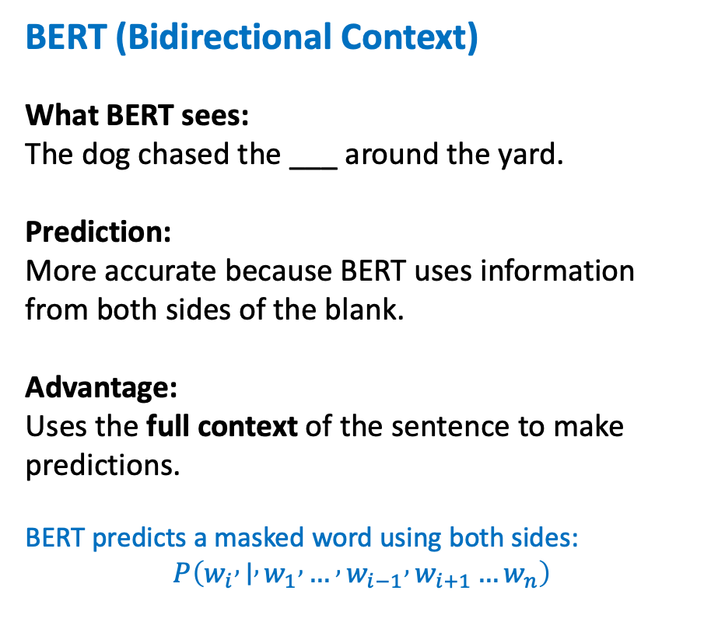

BERT Innovation #1: Bidirectional Context
Standard Language Model
What the model sees:
The dog chased the ___
Prediction:
cat
ball
Limitation: Only uses words that come before the blank, resulting in limited context.
BERT (Bidirectional Context)
What BERT sees:
The dog chased the ___ around the yard.
Prediction: More accurate because BERT uses information from both sides of the blank.
Advantage: Uses the full context of the sentence to make predictions.
BERT predicts a masked word using both sides:
$$P\left(w_{i} , ∣ , w_{1} , … , w_{i−1} , w_{i+1}…w_{n}\right)$$
Traditional language models predict the next word:
$$P\left(w_{t} , ∣ , w_{1}…w_{t−1}\right)$$
KEY TAKEAWAY: Traditional models are like reading with your eyes closed after the blank. BERT reads the entire sentence.
Notes:
First innovation: bidirectional context. A standard language model predicts words by only looking at what came before —> like reading left to right and stopping at the blank. It sees 'The dog chased the ___' and has to guess from just that context.
But BERT sees the entire sentence at once: 'The dog chased the ___ around the yard.' It sees both what came before AND what comes after. This gives BERT much richer context to understand what word belongs in that blank. That's the first major difference from standard Transformers —> they're unidirectional, BERT is bidirectional

Slide 5
BERT Innovation #2: Masked Language Modeling (MLM)
Training Example:
The movie was [MASK].
BERT learns to predict the missing word:
excellent
terrible
boring
Why it matters: BERT learns language by predicting hidden words using the surrounding context. This allows it to develop a deep understanding of word meaning and sentence structure.
Notes:
Second innovation: Masked Language Modeling, or MLM. Instead of learning to predict the next word like traditional language models, BERT hides random words in sentences —> replacing them with a [MASK] token —> and learns to predict what word should go there. It's like a fill-in-the-blanks game played on billions of sentences. This forces BERT to really understand context because it needs both left and right information to fill in the blank.

Slide 6
BERT Innovation #3: Next Sentence Prediction (NSP)
Example 1:
Sentence A: I went to the theater. Sentence B: I bought a ticket.
Are the sentences related? Yes
Example 2:
Sentence A: I went to the theater. Sentence B: Penguins live in Antarctica.
Are the sentences related? No
Why it matters: BERT learns relationships between sentences, helping it perform tasks such as question answering, text classification, and natural language understanding.
Notes:
Third innovation: Next Sentence Prediction. BERT also learns whether two sentences follow each other naturally or not. This teaches BERT about sentence-level relationships, not just word-level.
So BERT has three major differences from standard Transformers: bidirectional context, masked language modeling as its training task, and understanding sentence relationships. These three changes dramatically improve how well BERT understands language.

Slide 7
BERT Architecture: Built on Transformers
How BERT Processes Text
Input Sentence ↓ Tokenization (Break text into words/subwords) ↓ Embedding Layer (Convert tokens into numerical vectors) ↓ Transformer Encoder Layers × 12 (Apply bidirectional attention) ↓ Classification Output
Key Architectural Features
Encoder-Only Architecture
Uses only the Transformer encoder
Does not include a decoder
12 Stacked Transformer Layers
Each layer refines the representation of the text
Enables learning of complex language patterns
Bidirectional Attention
Considers both left and right context simultaneously
Creates richer contextual understanding
Notes:
Here's how BERT is structured. A sentence comes in, gets broken into tokens, converted to embeddings, then passes through 12 Transformer encoder layers —> these are the attention mechanisms that look in both directions.
Notice: BERT uses only the encoder part of the original Transformer architecture —> no decoder. This is a major architectural difference. The original Transformer used both encoder and decoder because it was designed for translation. BERT only needs the encoder to understand language deeply.
The encoder's job is to understand the input.
The decoder's job is to generate text.
Another key difference: at every layer, BERT's attention is bidirectional. It can look both forward and backward. This is what makes BERT fundamentally different from the original Transformer design, where attention is typically directional.

Slide 8
BERT in Action: Sentiment Analysis
Input Review: "I expected this to be boring, but the plot twist made it incredible.”
Standard Language Model
Focuses on: "boring"
Misses the reversal introduced by "but"
Prediction: Negative ✗
Example 2: Subtle Sentiment
Input Review:
"The movie wasn't the worst I've seen; it was actually pretty good.”
Standard Language Model
Struggles with negation ("wasn't")
May interpret "worst" as negative
Prediction: Unclear / Incorrect ✗
Why Bidirectional Context Matters:
BERT sees the entire sentence before making a prediction, detects sentiment reversals (but, however, although), captures subtle context shifts and nuanced language and therefore produces more accurate sentiment classifications
BERT
Considers the entire sentence
Recognizes "but" as a reversal cue
Understands the positive sentiment of "incredible"
Prediction: Positive ✓
BERT
Understands "wasn't the worst" as a positive statement
Combines this with "actually pretty good"
Prediction: Positive ✓
Notes:
So how does BERT help us? Let me show you why bidirectional context matters for real.
Look at this review: 'I expected this to be boring, but the plot twist made it incredible.' A standard left-to-right language model reads the beginning—> 'I expected this to be boring’—> and thinks: negative review. It stops there. But BERT sees the entire sentence at once. It reads the 'but' and sees 'incredible' at the end, and understands this is actually a positive review.
Or consider: 'The movie wasn't the worst I've seen; it was actually pretty good.' A standard model gets confused by the negation in the first part. But BERT sees both the negation AND the positive reinforcement at the end, and correctly classifies it as positive.
This is where BERT's bidirectional context is the game-changer. It doesn't get stuck on early words. It reads the whole sentence first, then makes a decision. This is why BERT handles nuanced, complex sentiment so much better than traditional models. It's not just that BERT is pre-trained, it's that the bidirectional architecture fundamentally changes how it understands language.

Slide 9
What You Should Remember About BERT
Feature | Original Transformer | BERT
Architecture | Encoder + Decoder | Encoder Only
Context Direction | Typically left-to-right during language modeling | Bidirectional
Training Objective | Predict next word | Masked Language Modeling (MLM) + Next Sentence Prediction (NSP)
Primary Use | Translation and sequence generation | Language understanding and classification
Notes:
To summarize: BERT takes the Transformer architecture and makes three key innovations. It uses bidirectional context instead of directional. It learns language through masked language modeling instead of next-word prediction. And it can be fine-tuned on any NLP task → sentiment analysis, question answering, named entity recognition — and perform extremely well because it has already learned language deeply.
That's why BERT was such a breakthrough: it showed that if you teach an AI to understand language deeply through bidirectional context and MLM, it can adapt to almost any downstream NLP task. Thank you.

